Slide 1


GROUP
PRESENTATION
Syndicate 3
Members:
Nivesh Maheshwari (210100102)
Tanishk Saxena (21D180041)
Kavan Vavadiya (210100166)
Rohan Choudhary (210040125)
Dhairya Meena (210100053)
Rohit Meena (210100128)
Himanshu Devatwal (210050065)

Slide 2

PROBLEM STATEMENT
APPROACH FOLLOWED
Introduction
Methodology
Overview
Survey
Results
Robustness checks
Conclusions
Drinking four cups of coffee for five days a week leads to anxiety

Slide 3

INTRODUCTION
Global Scenario
Literature provides findings that show that caffeine in coffees is associated with rise in anxiety in individuals, especially those consuming it at a higher rate - >400 mg caffeine. (Quinlan et al., 1997; Souissi et al., 2012; Jin et al., 2016; Distelberg et al., 2017; Chtourou et al., 2019;)
Literature suggested that Females are more prone to experiencing anxiety due to coffee consumption as compared to males (Lovallo et al., 2006)
Another study by Bernstein (2002) found that younger adults & adolescents tend to have a heightened response to coffee induced anxiety as compared to older adults

Slide 4
INTRODUCTION
Indian Scenario
Studies on the same topic in India are relatively lacking
One study conducted in Telangana examined the psychological effects of coffee consumption on students during online learning. The study employed tools such as the GHQ-12 to measure anxiety. Results indicated that moderate to high caffeine intake led to increased anxiety in students, especially those consuming more than two cups per day​ (IEOM Society)
Another analysis explored broader psychological impacts, noting that high caffeine consumption could contribute to anxiety disorders and depressive symptoms.

Slide 5
INTRODUCTION
Known Factors
Caffeine content
Consumption rate
Sleep disruption
Unknown Factors
Individual sensitivity
Genetic variability
Societal and Cultural influences
Medication interaction
Existing Gaps
Lack of intervention studies
Limited understanding of stress, anxiety and depression
Behavioural Habits
Hereditary issues of anxiety
Dishonesty while answering the questionnaire
Overestimating their ailments

Slide 6
CASE STUDY : COFFEE CONSUMPTION BEHAVIOR IN YOUNG ADULTS
A sample of 923 young adults (aged 16-40 years) from Alhasa, Saudi Arabia, participated in the survey.
Data were collected through self-reported questionnaires examining daily coffee intake, motivations (using the Caffeine Motives Questionnaire), adverse effects, and withdrawal symptoms.
Participants’ demographic information and lifestyle factors such as smoking and sleep duration were also recorded.

Slide 7
CASE STUDY : COFFEE CONSUMPTION BEHAVIOR IN YOUNG ADULTS
Key Findings:
Prevalence of Coffee Consumption:
Over 53% of participants consumed coffee regularly.
Coffee consumption was significantly higher in males, individuals aged 19-30 and smokers.
Coffee consumers tended to have poorer sleep patterns (3-5 hours/night) compared to non-consumers.
Unmarried participants consumed more coffee than married individuals.
Motivations for Coffee Consumption:
The main motivation for coffee consumption was reinforcing effects, such as enjoyment, taste, social aspects, and relaxation. This was more pronounced in females.
Other motivations included cognitive enhancement (alertness, energy) and negative affect relief (reducing stress and anxiety), though no significant gender difference was found in these motivations.
Coffee Consumption Types:
Dripper coffee was the most consumed type (85.59% of participants), with 20.1% of participants drinking coffee 2-3 times a day.
Other popular types were Arabic coffee(84.4%) and ice coffee(70.31%), while decaffeinated coffee was the least consumed (31.2%).

Slide 8
CASE STUDY : COFFEE CONSUMPTION BEHAVIOR IN YOUNG ADULTS
Key Findings:
4. Adverse Effects:
Common adverse effects reported included restlessness, shakiness, difficulty, sleeping, excitement, and a fast heartbeat.
Males reported higher rates of restlessness, excitement, and sleep difficulties, while females reported more shakiness and faster heartbeats.
5. Withdrawal Symptoms:
Headaches, mood changes, and tiredness were the most commonly reported withdrawal symptoms when participants reduced their coffee intake.
These symptoms were more prevalent in males than females.
6. Associations with Demographics and Lifestyle:
Coffee consumption was positively associated with age, gender, BMI, and smoking habits.
Obese participants were 3.5 times more likely to consume coffee than those with a normal BMI.
Participants from higher-income families were also more likely to consume coffee frequently.

Slide 9
CASE STUDY : COFFEE CONSUMPTION BEHAVIOR IN YOUNG ADULTS
Conclusions:
Coffee consumption in young adults is driven primarily by its reinforcing effects (taste and socialization), with adverse effects like restlessness and insomnia reported, particularly in high consumers.
Strategies should be developed to address excessive coffee consumption, especially considering its link to poor health outcomes, including sleep disturbances and withdrawal symptoms.
Study Limitations:
The study was limited by the convenience sampling method and the cross-sectional design, which restricts causality claims. Additionally, the sample was predominantly male and drawn from a single region, limiting the generalizability of findings.

Slide 10
METHODOLOGY
Study Setting
This study examines the impact of coffee consumption on anxiety levels among engineering college students. The study aims to explore potential correlations between caffeine intake and anxiety, providing insights into how coffee consumption affects students' mental well-being in a demanding academic environment
Time Period
We looked at consumption patterns that have been prevalent over the course of the last couple of years
Type of Design
Observational analytical study specifically a cross-sectional study
Sample Size
This research was carried out in engineering colleges among a sample of 86 students out of which 61 were males and 25 were females

Slide 11
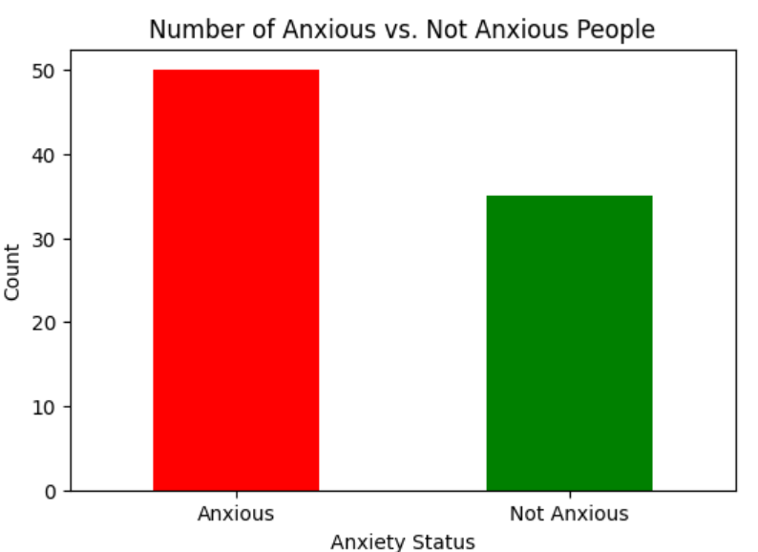
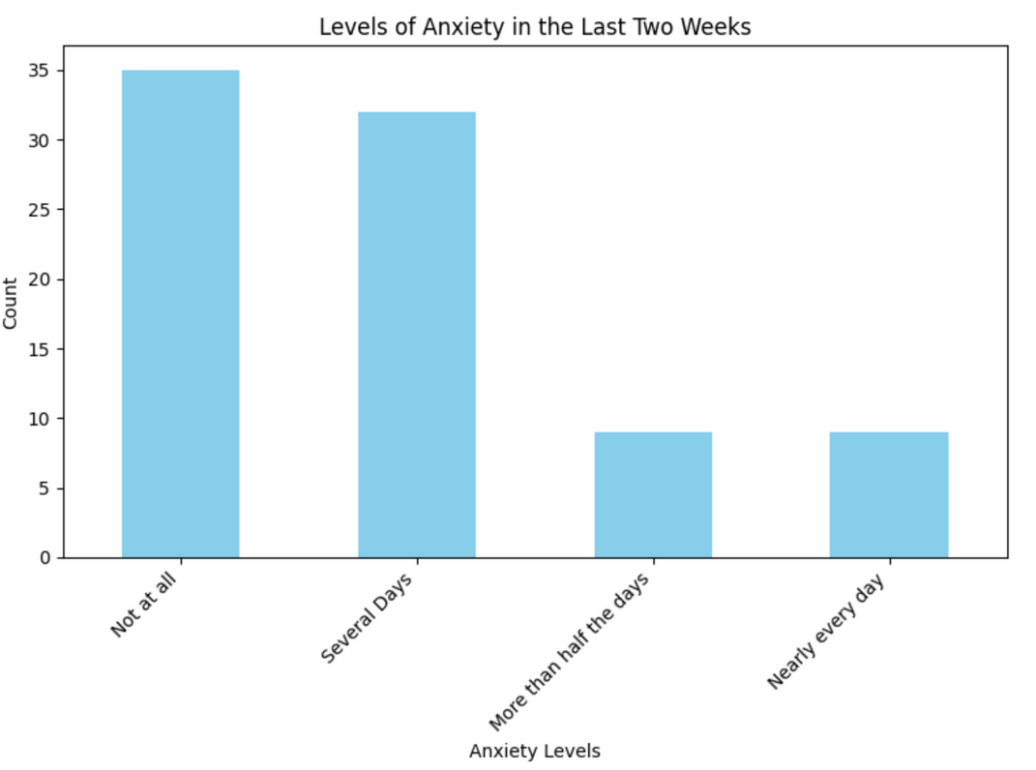
SURVEY ANALYSIS

Slide 12
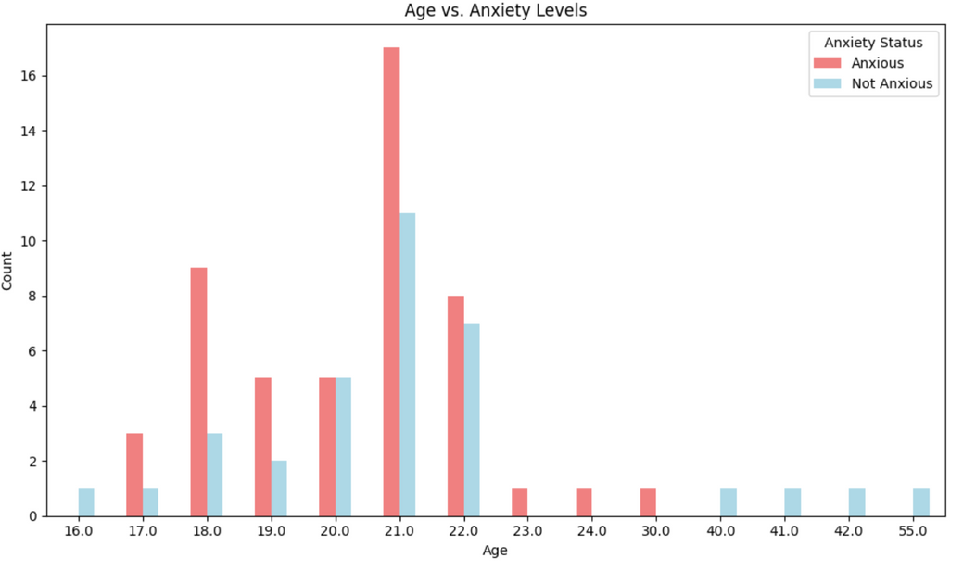
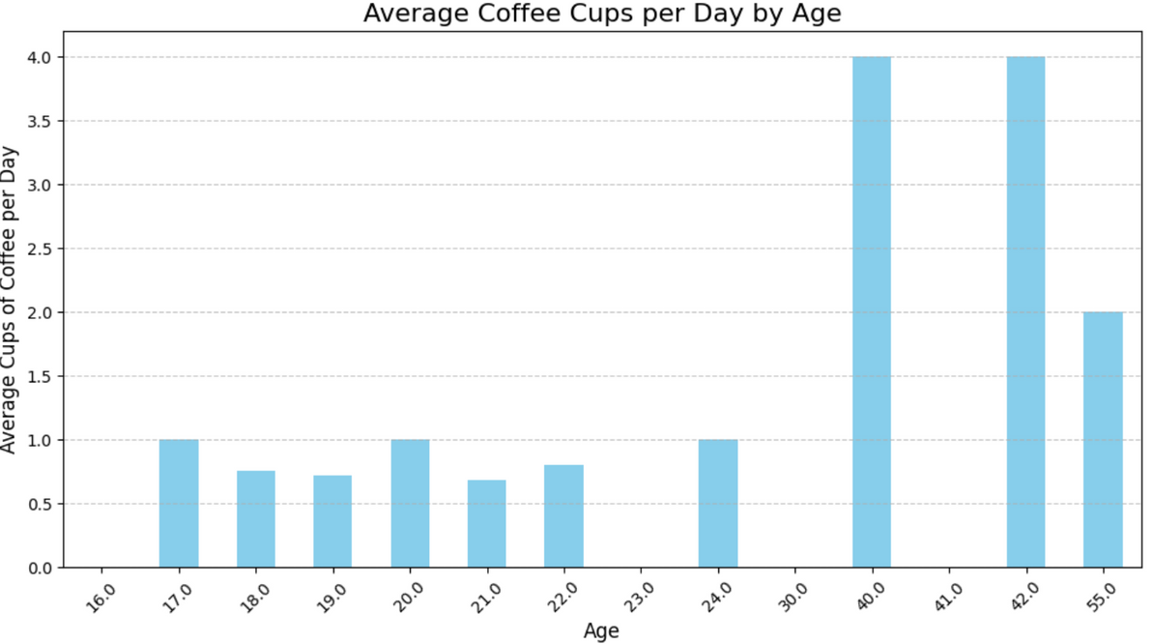
SURVEY ANALYSIS
1)Age-Confounder: Age can affect both coffee consumption habits and anxiety levels. For example, younger individuals may metabolize caffeine differently and may experience stress or anxiety due to academic or career pressures, making it a confounder.

Slide 13
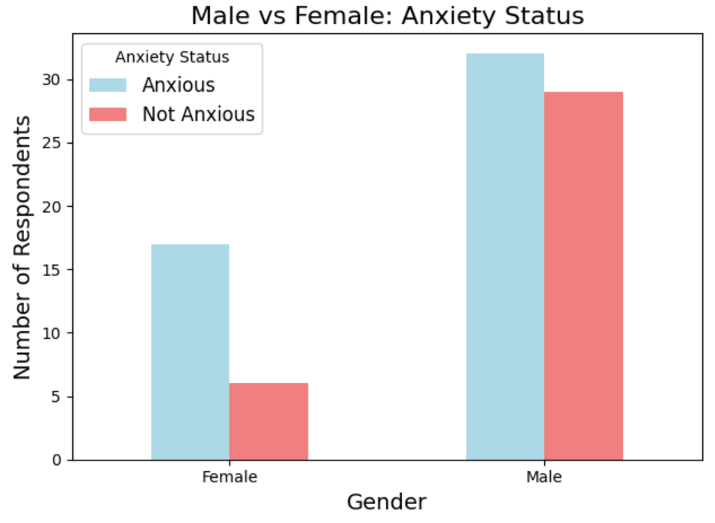
SURVEY ANALYSIS
2)Gender-Confounder: There may be gender differences in how individuals metabolize caffeine and experience anxiety. Gender could influence both coffee consumption patterns and the likelihood of feeling anxiety, making it a potential confounder.

Slide 14
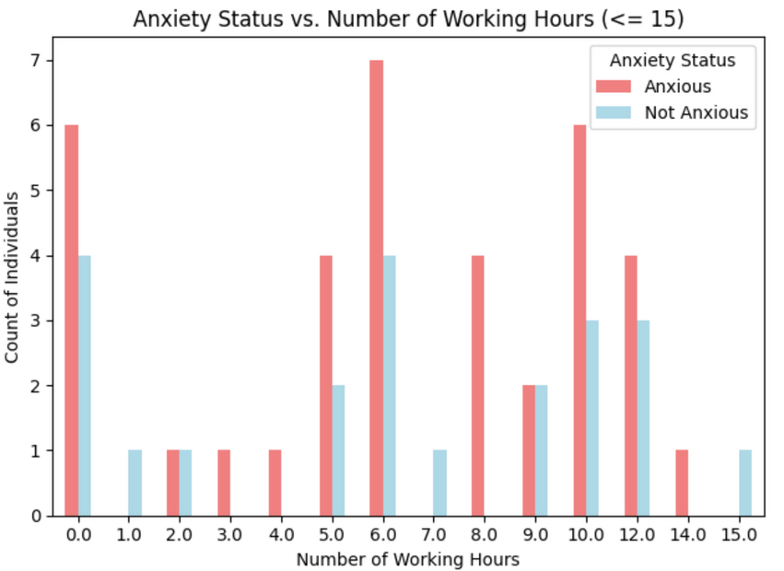
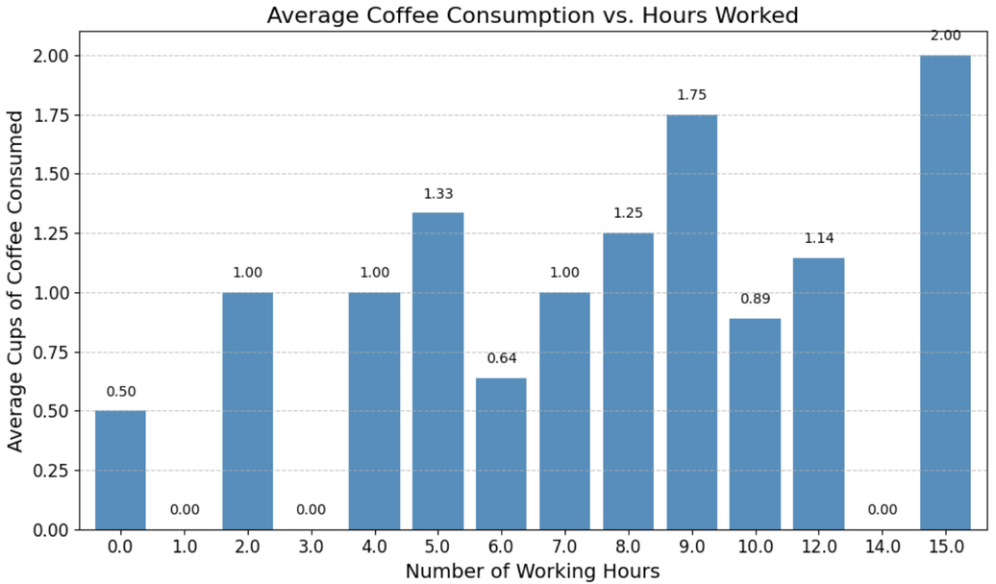
SURVEY ANALYSIS
3)No. of Working Hours-Confounder: Longer working hours might lead to increased coffee consumption to stay awake, and the stress of long hours could contribute to anxiety. Hence, it's a confounder.

Slide 15
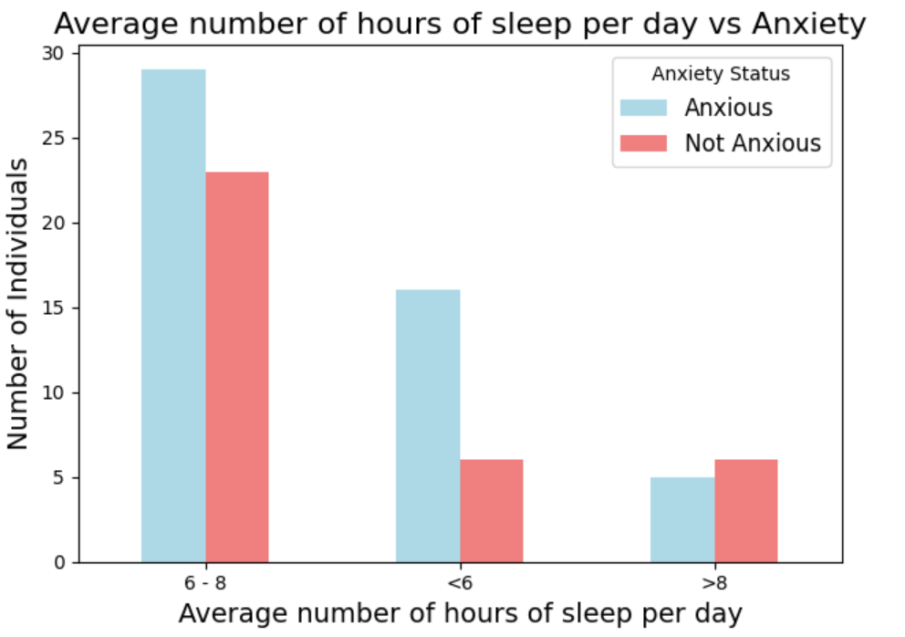
SURVEY ANALYSIS
4)Average number of hours of sleep per day-Confounder: Lack of sleep is closely related to both coffee consumption (to compensate for tiredness) and anxiety. It’s a strong confounder.

Slide 16
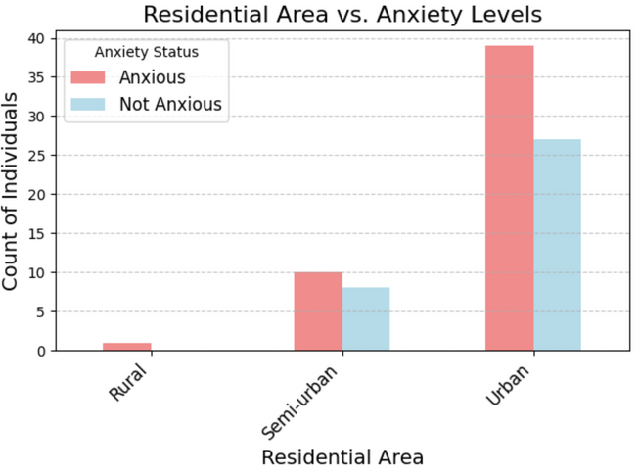
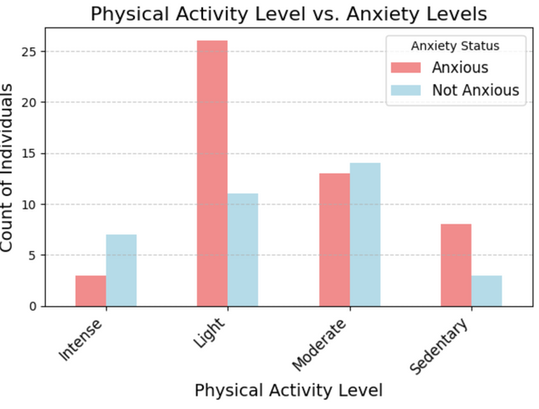
SURVEY ANALYSIS
5)Residential Area - Possibly Irrelevant/Bias: Where someone lives (urban vs. rural) might influence lifestyle, but it seems less likely to directly affect coffee consumption and anxiety in this context. However, it could introduce bias if certain living conditions correlate with stress or caffeine habits.
6)Physical Activity Level - Confounder: Physical activity can reduce anxiety and influence energy levels, possibly affecting coffee consumption. It's a potential confounder.

Slide 17
SURVEY ANALYSIS
7)Smoke or use tobacco - Confounder: Smoking and tobacco use can affect anxiety levels and are often associated with increased caffeine consumption. It's a potential confounder.
8)Consume alcohol - Confounder: Alcohol consumption can affect mental health and anxiety, as well as interact with caffeine. It’s a confounder.
9)Consumption of other caffeinated beverages – Confounder: Other caffeinated beverages may contribute to total caffeine intake and have similar effects on anxiety as coffee. This is a confounder that must be considered.
10)Occupation – Confounder: Occupation could affect stress levels, which are related to anxiety, as well as the frequency and amount of coffee consumption (e.g., certain high-pressure jobs). It’s a confounder.

Slide 18
SURVEY ANALYSIS
11)Previous diagnosis with anxiety or any related disorder – Bias: People with a prior diagnosis of anxiety might report heightened sensitivity to coffee or already experience anxiety, which could bias the results. However, with few cases in your sample, this bias might not be strong.
12)Pre-existing health conditions – Bias: If most respondents don’t have pre-existing conditions, it’s not likely to directly confound the relationship. However, it could introduce bias, as health conditions could affect both coffee consumption and anxiety.
13)Medications that affect your mental health – Bias: Medications for anxiety and other mental health issues could influence the survey results by artificially altering anxiety levels. Given the low prevalence in your sample, it may not significantly affect the outcome, but it could introduce bias.

Slide 19
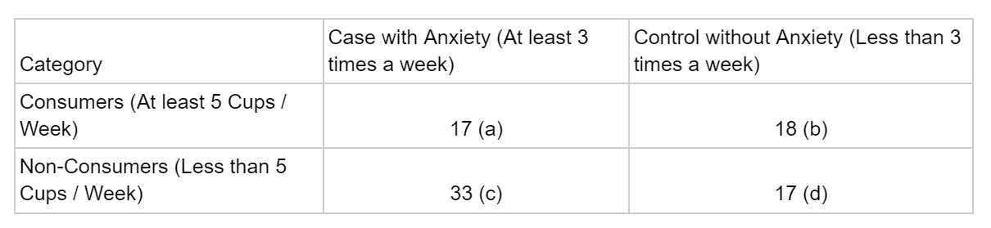
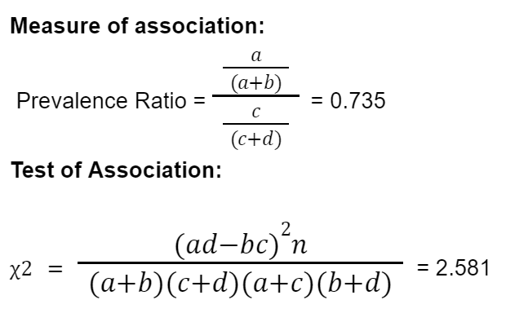
RESULTS
Majority of respondents consumed fewer than 20 cups of coffee per week, with a mean intake of 5 cups. Therefore, we had to adjust the hypothesis to align with the actual data collected.
Cases = a + c = 17 + 33 = 50
Controls = b + d = 18 + 17 = 35

Slide 20
RESULTS
Our study found a weak or inverse relationship between 5 cups per week and anxiety (e.g., the prevalence ratio of 0.735), we could speculate that a higher intake of coffee might increase anxiety, based on the existing body of research that suggests larger caffeine consumption correlates with anxiety.
While our study did not directly test 20 cups per week, the lower intake levels in our sample provide an initial indication that a higher consumption may be more closely linked with anxiety.
While this study primarily focused on an average intake of 5 cups per week due to the sample's characteristics, it provides initial insights that may hint at the potential relationship between higher coffee consumption and anxiety. Although we cannot statistically support the original hypothesis of 20 cups per week leading to anxiety, prior research and trends observed suggest that future research should explore higher consumption thresholds to better understand this connection.

Slide 21

CONCLUSION
Strong Confounders: Age, gender, occupation, working hours, sleep, physical activity, consumption of other caffeinated beverages, smoking, alcohol consumption
Bias or Lesser Confounders: Pre-existing health conditions, mental health medications, previous diagnosis of anxiety
Possibly Irrelevant/Bias: Residential area

Slide 22
FUTURE OF RESEARCH
Since our current study primarily focused on students with lower coffee consumption, we could hypothesize that a similar study on working professionals would result in a higher average intake, which could lead to stronger evidence supporting our original hypothesis.
We could propose a future study focusing on working professionals, where variables like higher working hours, sedentary lifestyle, and accessibility to coffee might provide a more conducive environment to test the hypothesis of whether higher coffee consumption (such as 20 cups per week) leads to anxiety.

Slide 23

CONCLUSION BASED ON VARIOUS OTHER RESEARCH
Coffee consumption in young adults is primarily driven by its reinforcing effects such as enjoyment, taste and socialization
In heavy consumption: males reported higher levels of restlessness and sleep disruption, while females experienced symptoms like shakiness and increased heart rates.
Reducing coffee intake led to withdrawal symptoms such as headaches, mood changes, and fatigue, with males experiencing these symptoms more intensely than females
Factors like age, gender, and lifestyle (including smoking habits and BMI) were found to significantly influence coffee consumption patterns. Males, smokers, and those with higher BMI tend to consume more coffee.
Strategies to reduce excessive coffee intake should be considered, given the like to poor health outcomes like sleep disturbances.

Slide 24
LIMITATIONS
The sample size was relatively small consisting 86 participiants which may not represent broader population
Majority of the participants were students aged between 20-26
Few cases of pre-existing health conditions, previous diagnoses with anxiety, or any related disorder by a medical professional

Slide 25
RESOURCES
Ahsan, F., and S. Bashir. "Coffee consumption: health perspectives and drawbacks." J. Nutr. Obes 2.1 (2019)
Lone, Ayoob, et al. "Coffee consumption behavior in young adults: exploring motivations, frequencies, and reporting adverse effects and withdrawal symptoms." Psychology Research and Behavior Management (2023): 3925-3937

Slide 26
THANK YOU!

